Slide 1
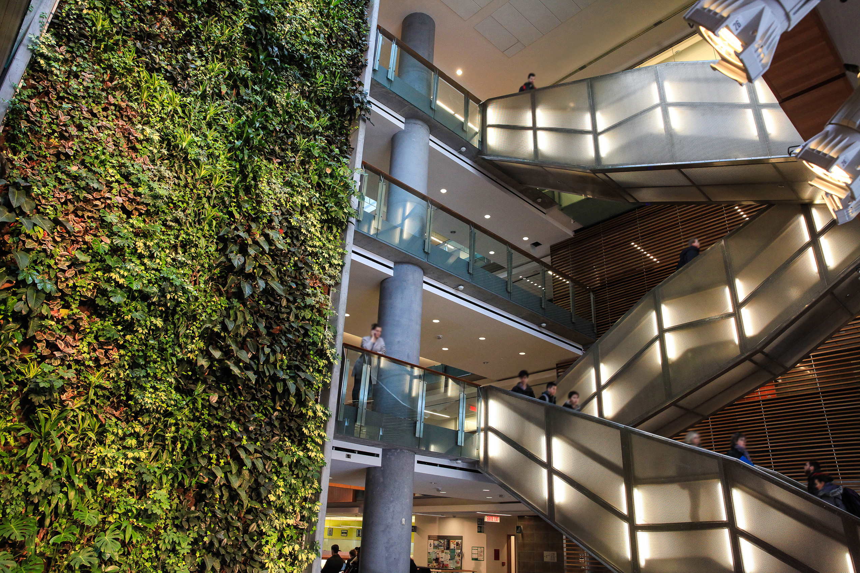

ELG 5163 – Machine Vision
Project Presentation
Inter-vehicle distance estimation using displaced stereoscopic vision
Presented by: Alfa Budiman, Mathieu Falardeau Date: 31/03/2022
Faculté de génie | Faculty of Engineering
uOttawa.ca
Notes:
PAGE COUVERTURE (option 1) ÉBAUCHE (DOCUMENT NON FINALISÉ) À lire avant d’utiliser le gabarit
NOTE : Les éléments du gabarit suivants ne peuvent être modifiés : • Entête organisationnelle grenat (Université d’Ottawa | University of Ottawa) • Pied de page organisationnel comprenant la bande grise et violet foncé ainsi que le logo, à l’exception de l’adresse Web qui peut être modifiée en suivant les étapes suivantes : dans le document PowerPoint, cliquez sur l’onglet View, puis sélectionnez Slide Master. Sur le menu d’affichage (à gauche), sélectionnez la troisième diapositive et inscrivez la nouvelle adresse sur celle-ci.
COVER PAGE (option 1)
DRAFT ONLY (FILE NOT FINAL) Read before using template
NOTE: The following elements of the template should remain untouched and cannot be modified:
• Corporate (Université d'Ottawa | University of Ottawa) garnet header
• Corporate uOttawa footer including the grey/dark purple stripe and logo, with the exception of the URL which can be customized to a specific URL by following these simple steps: On the PowerPoint View tab, in the Master Views group, select Slide Master. Select the third slide on the left side panel, and type in the desired URL on the slide.

Slide 2


1
Alfa Budiman abudi097@uottawa.ca
Mathieu Falardeau mfala097@uottawa.ca

Slide 3
Aim
2
Present our ELG 5163 Machine vision term project and provide insight on a different approach to the traditional stereoscopic vision.

Slide 4
Outline
3
Introduction
Problem Description
System Description
Methodology:
Object Detection
Direction Calculation
Distance Calculation #1
Distance Calculation #2
Test & Results
Discussion and Conclusion

Slide 5
Introduction

Slide 6
Methodology
3
Object Detection and Feature Matching
Detect red pixels on burgerbot and black pixels on wafflebot
Direction Calculation
Calculate relative direction from respective cameras
Position Calculation
Quadcopter and wafflebot positions are known
Relative directions to burger bot are known
Complete triangle to find position of burgerbot
Distance Calculation
Difference between wafflebot and burgerbot positions
Notes:
1 min,
Go over 4 step process of vision based distance estimation
Step 1 – object (a red burgerbot) is observed, detected and tracked from 2 cameras, one overhead on a quadcopter, and one mounted on a wafflebot.
Step 2 - the direction to the object from both observers is estimated as a unit vector by using the pixel coordinates of detected object
Step 3 – with the positions of observers known and direction (unit vector) to object known, the position of the object can be calculated
Step 4 – the distance from the observers to the object is the difference between their positions

Slide 7
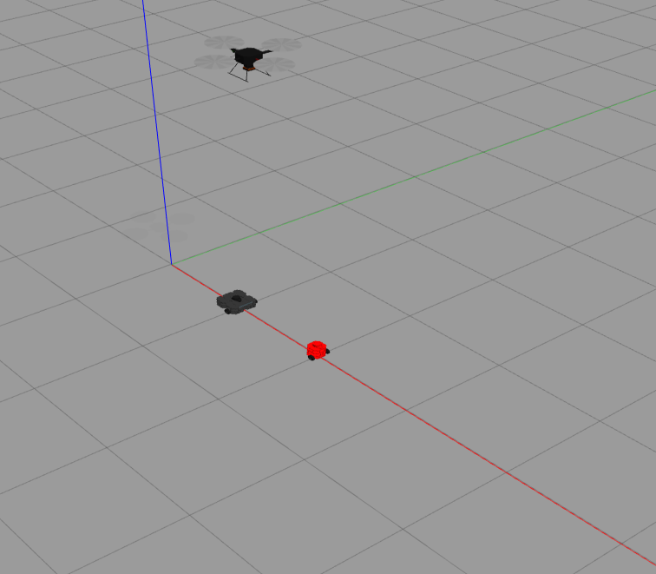
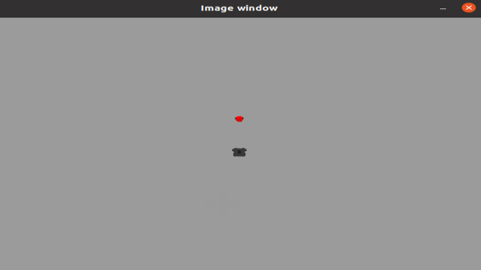

Object Detection and Feature Matching
Quadcopter camera
Wafflebot camera
Notes:
Object detection and feature matching
Quadcopter camera detected groups of black pixels and red pixels
Center of black pixels is wafflebot. Red pixel closet to center of black pixels is burgerbot
Wafflebot camera detected red pixels. Center of red pixels is burgerbot.

Slide 8
Methodology
3
Direction Calculation

Slide 9
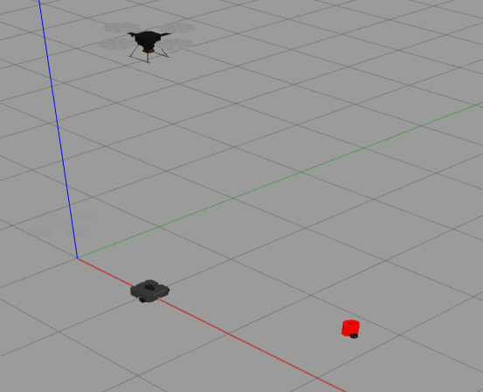
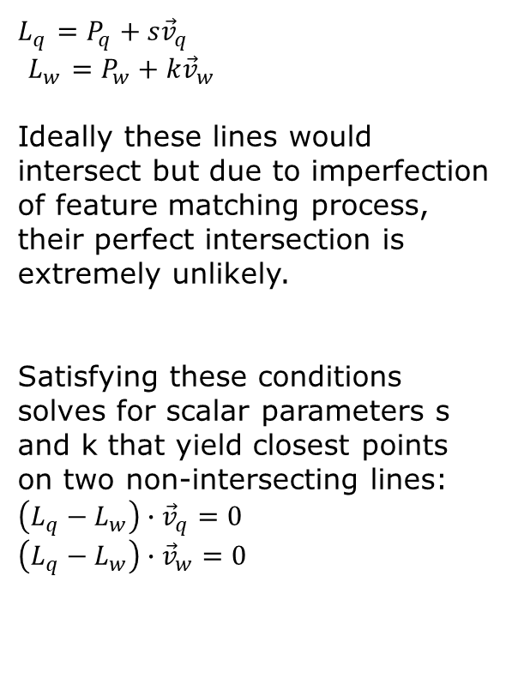
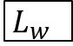
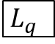
Distance Calculator 1
$L_{q}$ $=P_{q}+s{\vec{v}}_{q}$
$L_{w}$ $=P_{w}+k{\vec{v}}_{w}$
Ideally these lines would intersect but due to imperfection of feature matching process, their perfect intersection is extremely unlikely.
Satisfying these conditions solves for scalar parameters s and k that yield closest points on two non-intersecting lines:
$\left(L_{q}−L_{w}\right)∙{\vec{v}}_{q}=0$ $\left(L_{q}−L_{w}\right)∙{\vec{v}}_{w}=0$
$L_{q}$
$L_{w}$
Notes:
1 min 30 ish ish

Slide 10
Methodology
3
Distance Calculator 2

Slide 11
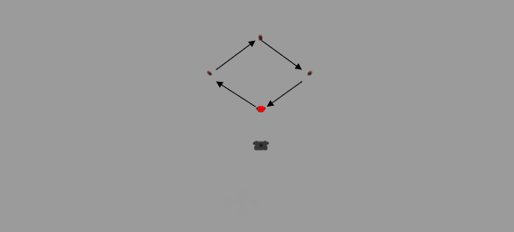
Test Drive
3
Burgerbot drove through 4 waypoints under observation from quadcopter and wafflebot.
Test 1 – stationary observer. Test 2 – leader / follower. Same burgerbot path in both tests
Notes:
1 min ish

Slide 12

Test Drive - Stationary
3
Notes:
1 min ish

Slide 13
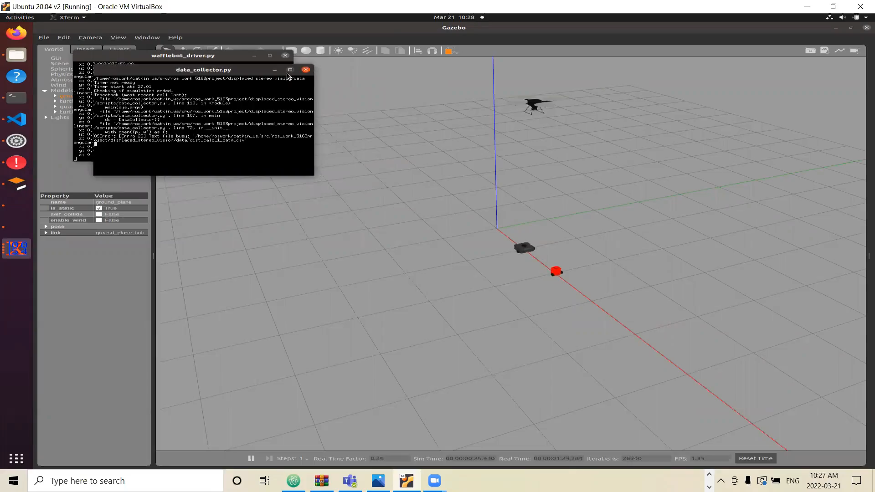
Test Drive – Leader Follower
3
Notes:
1 min ish

Slide 14
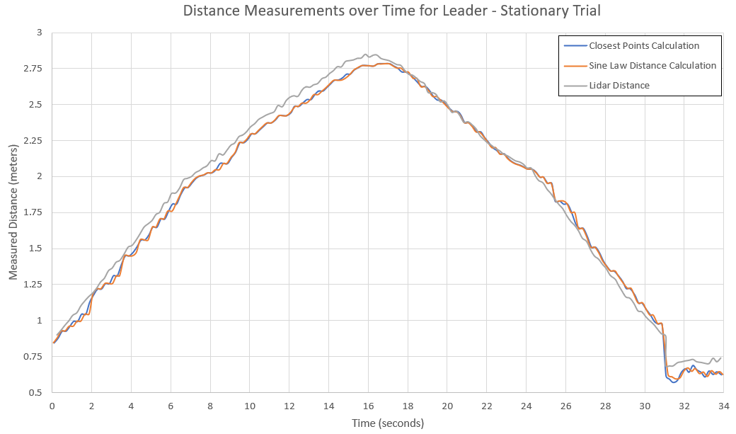
Results and Discussion
3
Stationary Test
Image of path here
Notes:
- Good distance measurement between both vision based methods compared to lidar

Slide 15
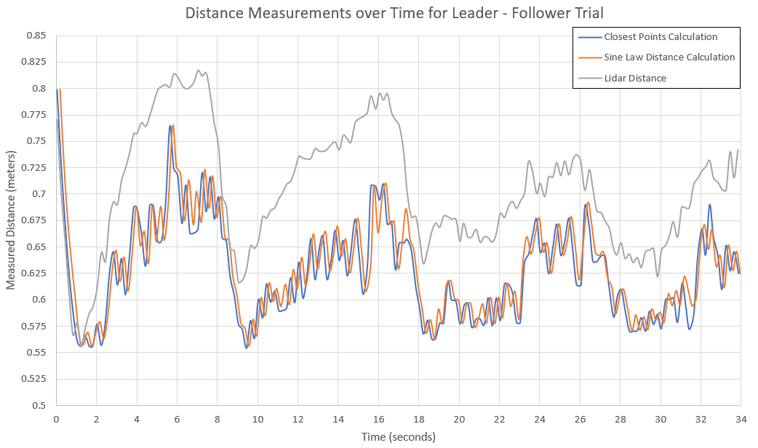
Results and Discussion
3
Leader / Follower Test
Notes:
Distance measurement is good but starts to deviate when the wafflebot starts moving to catch up to the burgerbot
Error is less when wafflebot is stationary, which occurs when it is rotating to orient itself to face the burgerbot

Slide 16
Discussion
3
Applications:
Multi-robot path planning
Leader follower with obstructing obstacles
Distance measurement over uneven terrain (hills)
Further improvement
Improve robustness of object detection
Improve robustness of feature matching
Detection of different object types

Slide 17
Conclusion
3
Vision from a UGV and a UAV was combined to measure distance between a UGV and a moving object.
Effective for stationary UGV.
Requires further development on object detection and feature matching.

